Slide 1
AIM1202 Marketing Communication
Week 14
Isari Pairoa
isaritiaw@gmail.com
MB. 086-358-3508

Slide 2
Week 14 | Chapter 10 Digital Marketing Strategies -Meaning of digital marketing -Importance of digital marketing -Objectives of Digital Marketing - Strategies of marketing through digital media. -Types of digital marketing tools -Evaluation of digital marketing strategies - Case studies of digital marketing

Slide 3
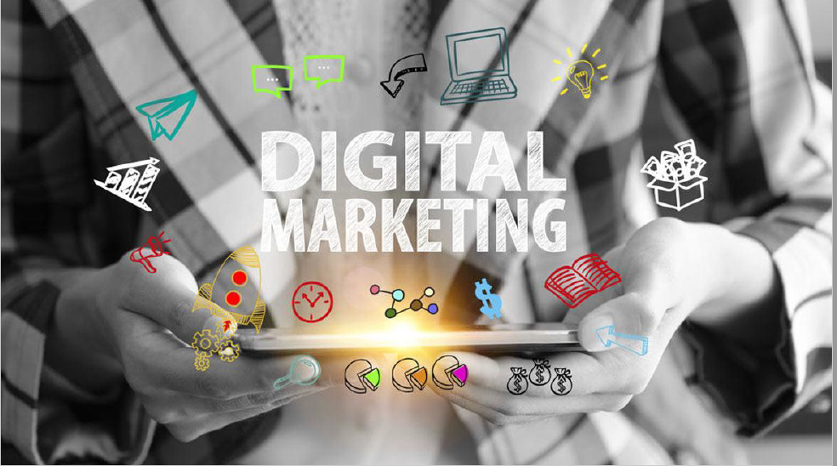

Slide 4
Definition of Digital Marketing
Definition of Digital Marketing which consists of digital media Digital marketing, online media, electronic business, which means media with text, graphics, animations audio and video Let's convert and link together for the benefit of use. by relying on the advancement of computer technology The marketing communication has developed the market in the future.

Slide 5
Definition of Digital Marketing
When the company conducts most of its marketing operations through digital communication channels. using social media as a tool for social practice It is a form of electronic advertising. or promoting the company's marketing to business customers using the Internet to send news and close sales. Digital marketing is the use of technology to reach consumers through digital channels.

Slide 6
The importance of digital marketing
When digital media is applied to that marketing There are several things that need to be emphasized, namely the response aspect. communication personal response Consumer demand Invisible Advertising conformity aspect of identity Marketing through digital media is important to business, being able to clearly target customers. Able to send information about products or services directly to target groups. by facilitating sales staff

Slide 7
Evaluate decisions about the number of interested parties clearly. and can collect target audience information Consistent with the importance to consumers, that is, it can be used as information for decision making. Convenience in choosing products and create satisfaction for target customers Digital marketing is one of the most important marketing communications for a successful business.

Slide 8
And achieve the objectives according to the specified business goals. Because marketing through digital media It is a new alternative marketing communication that saves budget in marketing communications.

Slide 9
Objectives of Digital Marketing
for the company to be more convenient in marketing communications so that the company can quickly define and modify the content of the news for more and faster customer interactions To be a tool that helps build good relationships with customers in the most effective way. To be a channel that plays an important role in the purchasing decisions of today's consumers. and marketing through social media

Slide 10
Its purpose is to increase likes. Sharing stories and talking about creating an email marketing strategy. Creating Brand Experiences with Smartphone Marketing The objective of digital media marketing is the mechanism that makes effective digital marketing communication strategies. in order to run the business successfully

Slide 11
Digital Marketing Strategy
Connection
Conversation
Co-Creation
Commerce
Community

Slide 12
Types of digital marketing tools
Website
Email
Blog
Social Media
Search
Online Video
Digital Games
Influencer

Slide 14
Behavior-based measurement and evaluation of target audiences.
The company can measure the performance of the website from a number of things by measuring and evaluating the behavior of the target audience:
1) increase in purchase volume
2) click purchase rate
3) brand awareness. And brand awareness
4) Number of visitors
5) Length of stay on the website
6) Number of types of information received

Slide 15
Evaluation of digital marketing strategies (Digital Marketing) can also be measured and evaluated by type of digital marketing tools:
1) Facebook Likes
2) Advertising through online video content 3) Measurement will be more accurate with different types of measurement tools
By evaluating the digital marketing strategies mentioned above will make the business successful. But the assessment needs to be detailed. and at the same time must be able to keep up with competitors in marketing communications

