Slide 1
AIM1202 Marketing Communication
Week 1
Isari Pairoa
isaritiaw@gmail.com
MB. 086-358-3508

Slide 2
Join this group online

Slide 3
Agreement

Slide 4
Agreement
Check your name. Do not sign your name instead. Do not come to class more than 15 minutes late. After 15 minutes but within 30 minutes of class start teacher asks for a reason but considered to be lacking Half of the half times (Late in this case, 4 times is considered 1 absence) by requesting to enter the classroom and sign your name. with a sign indicating that you are late
More than 30 Teachers are allowed to attend, but it is considered half absent (2 times late in this case is 1 absence) by requesting to enter the class and signing your name. with a sign indicating that you are late
leave Sick leave. Call the teacher before class. And if in the case of a break from studying for 2 weeks in a row Submit a medical certificate Take a business leave, make a document to notify the teacher 1 week in advance. Missing more than 3 times. Missing the 4th time. The teacher invites the parents to meet to find out the study guidelines of that student.

Slide 5
Agreement
inside the classroom
Turn off phones and all communication devices. or turn it on as a vibrating system If students want to talk on the phone ask for permission from the teacher and go out to talk outside the classroom The teacher gave me 15 minutes to talk. More than that was not allowed to continue the class. considered absent from school
Please do not play all kinds of community and chat such as Facebook, WhatApps, Lines, MSN, Instagram, etc. in the classroom unless the teacher allows activities through the community only. Permission to conduct personal business Raise your hand and ask for permission. The teacher gave me 15 minutes to do personal business, more than that was not allowed to continue the course. considered absent from school

Slide 6
details in class
Objective
for students to understand the roles and methods of marketing communication As a powerful marketing tool and is very popular nowadays The knowledge of marketing communication planning through various tools can be used as a basis for studying advanced courses in advertising and other marketing communications.

Slide 7
course description
Meaning, concepts and roles of marketing communication. The role of the marketing mix in acting as a marketing communication tool. to convey ideas from entrepreneurs to target consumers Planning Guidelines marketing promotion activities To communicate with consumers in a variety of ways, including advertising, public relations. Sales promotions, services and other marketing communication tools

Slide 8
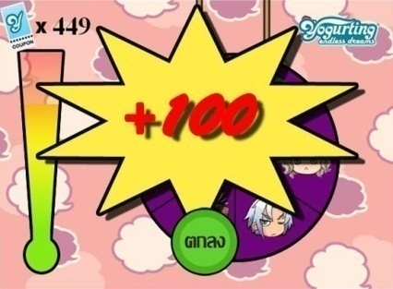
Evaluation
As for the content of the course, look at the teaching guidelines distributed
Methods for assessing learning outcomes | Assessment week | proportion of evaluation
1. Spirit (attendance / etiquette / dress code) | throughout the semester | 10
2. Lesson based exercises (activities / class work / case study analysis) | 1-7 | 20
3. Sub-score test | 8, 9, 10 11, 12, 13, 14, 15 | 10
4. Midterm exams | 8 | 30
5. Final exam | 16 | 30

Slide 9
Assignment 1 Time 45 Mins
What kind of person do you think the students are? What are their strengths and weaknesses?
Imagine yourself by drawing a cartoon character representing yourself as an animal with a description.
Why did you choose to study Communication Arts?
Why did you choose this major?
What are your plans after graduation?
How do you see yourself 5 years after graduation?
3 words that you think are yourself
Name, surname, nickname, phone number and email Major, where did you graduate from high school?
*The teacher asked students who did not come to make this paper to submit no later than the 2nd week.

Slide 10
Home work
1. what is marketing Explain with examples
2. what is communication Explain with examples

Slide 11
solo work
notebook, whole semester
Individual work files for the whole semester

Slide 12
Agreement
Single work, collect all work
Group work collects all the work.
Do not send 40 lost points.

