Slide 1
How to write the thesis
Film production : CFD 4801

Slide 2
Script Composition Theories
(Kittipong Wongthip, 2007) gave an idea for the design of the story in the article. Elements of writing in the genre of fiction that storytelling art Be it a story, a novel, a drama, or a movie, they all have the same foundation
(Asst. Prof. Dr. Raksan Wiwat Sinudom, 2015) gave the idea of writing a movie screenplay in the book Writing Entertainment Movie Screenplay that The concept of screenplay writing is a step-by-step process, each step is a sequence of key ideas and then gradually adds layers of detail step by step

Slide 3
The steps of writing are as follows.
1. Concept (Idea)
2. Theme
3. Storyline (Plot)
4. Expanded storyline (Treatment)
5. Screenplay
6. Story board

Slide 4
finding idea
IdeaFinding the plot of a screenplay is the first process in screenwriting. The concept of the story must be new, not repeated, creative, meaning the idea of creating excitement (Exciting) to the audience.
    Finding ideas to spark writing A screenwriter can be developed from a variety of sources. may arise from asking questions Finding information and observing the surroundings including experience

Slide 5
theme
The theme or theme (Theme) is the point of the story. assumptions that lead to conclusions The whole point of the story was condensed into a single sentence. There are other words that have similar meanings such as Promise, Root idea, Concept, Thesis, Goal. This main idea connects all factors of the story. such as the plot (Plot), characters, style and details of the screenplay to be consistent as one In the same direction, which is the main goal and purpose of filmmakers who want to communicate or tell to the audience.

Slide 6
Plot and Treatment
Expanded storyline (Treatment) After getting a strong plot (Plot) Have a clear theme or point Then start bringing it to expand.
  How to extend the term Sequence Arranging is the sequence of events. on the subject and develop it. It is the separation of the story from the storyline into parts. Each section is called a sequence, a section or section in a chapter. Each sequence consists of multiple scenes or a single scene.

Slide 7
Screenplay
The following link is an example of the screenplay
    chrome-extension://efaidnbmnnnibpcajpcglclefindmkaj/https://www.nolanfans.com/library/pdf/thedarkknight-screenplay.pdf

Slide 8
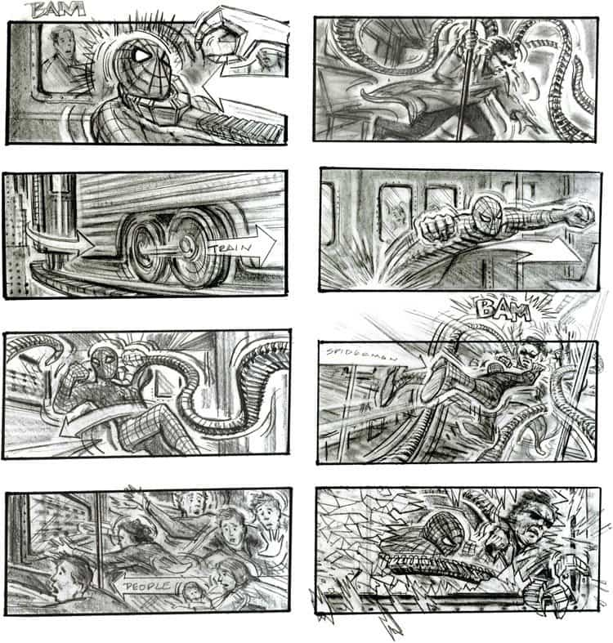
Story board
Example of spiderman story board

Slide 9
Home work
Write your own thesis by using 6 steps of film thesis writing

